Slide 1

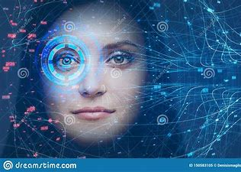
ATTENDANCE USING FACIAL RECOGNITION
By:
Rohit raj & Abhishek kumar

Slide 2
